Slide 1

Introduction to Machine Learning
Paul Fannon

Slide 2
In today’s session
You will be learning:
More about interpreting PCA
How to do PCA in R
(Time permitting) An alternative to PCA for non-linear situations called tSNE.

Slide 3
Exploring PCA With the Iris Data Set
# This library has some nice plots to visualise PCA
library("factoextra")
# Import the iris data set.
data(iris)
# Explore the iris data set
head(iris)
summary(iris)

Slide 4
Exploring PCA With the Iris Data Set
# Explore some of the correlations graphically
# First plot Sepal width against sepal length, colouring by species
ggplot(iris, aes(x=Sepal.Length, y=Sepal.Width, color=Species))+
geom_point()

Slide 5
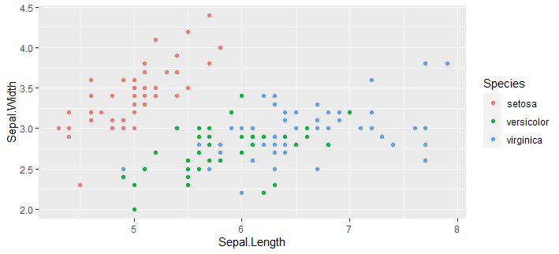
Exploring PCA With the Iris Data Set

Slide 6
Exploring PCA With the Iris Data Set
# Prepare the iris data for PCA by removing the species label
iris.prepared <- iris[,1:4]
#Do the PCA, rescaling the data automatically.
iris.pca <- prcomp(iris.prepared, scale=TRUE)
#Explore the first few data items in terms of the Principal Components
head(iris.pca$x)

Slide 7
Exploring PCA With the Iris Data Set
PC1 PC2 PC3 PC4
[1,] -2.257141 -0.4784238 0.12727962 0.024087508
[2,] -2.074013 0.6718827 0.23382552 0.102662845
[3,] -2.356335 0.3407664 -0.04405390 0.028282305
[4,] -2.291707 0.5953999 -0.09098530 -0.065735340
[5,] -2.381863 -0.6446757 -0.01568565 -0.035802870
[6,] -2.068701 -1.4842053 -0.02687825 0.006586116

Slide 8
Exploring PCA With the Iris Data Set
#Draw a Scree plot to check how many principal components are useful
fviz_screeplot(iris.pca)

Slide 9
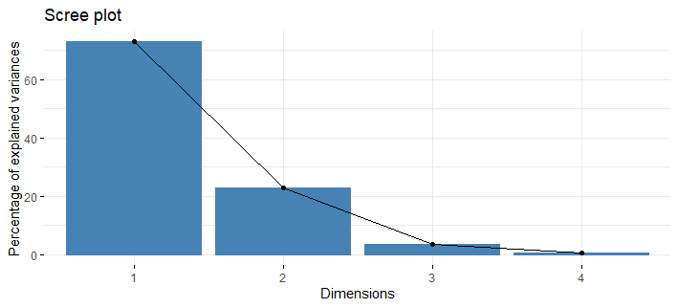
Exploring PCA With the Iris Data Set

Slide 10
Exploring PCA With the Iris Data Set
# add species information back into PCA data
iris.pca.data <- data.frame(iris.pca$x, Species=iris$Species)
# plot the PCA data, coloring the points by species.
ggplot(iris.pca.data, aes(x=PC1, y=PC2, color=Species))+geom_point()

Slide 11
Exploring PCA With the Iris Data Set
# add species information back into PCA data
iris.pca.data <- data.frame(iris.pca$x, Species=iris$Species)
# plot the PCA data, coloring the points by species.
ggplot(iris.pca.data, aes(x=PC1, y=PC2, color=Species))+geom_point()

Slide 12
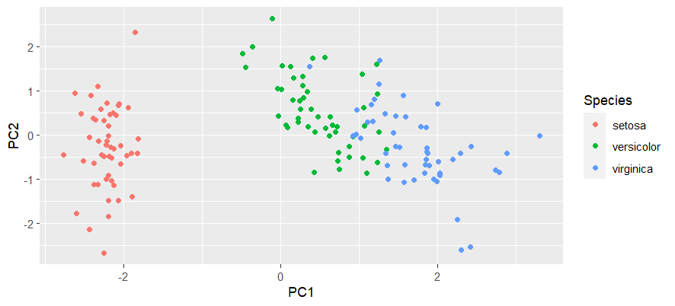
Exploring PCA With the Iris Data Set

Slide 13
Exploring PCA With the Iris Data Set
# draw a correlation circle
fviz_pca_var(iris.pca)

Slide 14
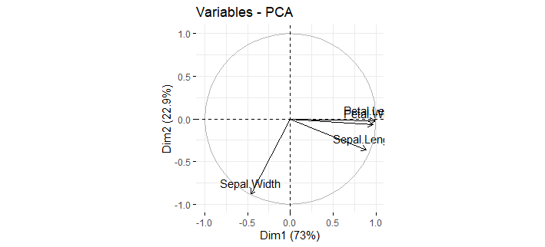
Exploring PCA With the Iris Data Set

Slide 15
Exploring PCA With the Iris Data Set
# draw a biplot
fviz_pca_biplot(iris.pca, col.ind=iris$Species, label="none")

Slide 16
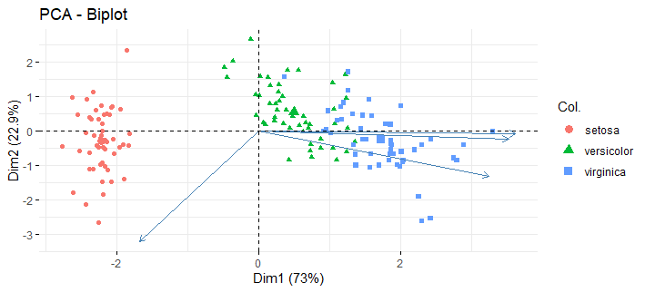
Exploring PCA With the Iris Data Set

Slide 17
Exploring PCA With the Iris Data Set
#draw a stripchart to analyse the plausibility of using just one principal component
stripchart(PC1 ~ Species, data=iris.pca.data, method="jitter", col=c("blue", "green", "orange"))

Slide 18
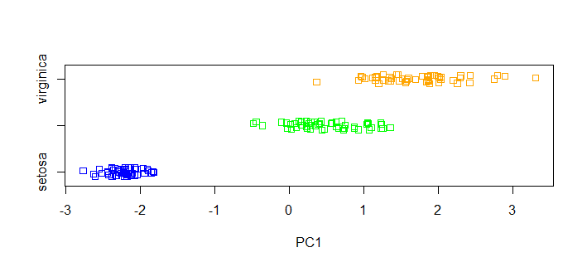
Exploring PCA With the Iris Data Set

Slide 19
Exploring PCA With the Iris Data Set
# explore the transformation from the original data
print(iris.pca$rotation)
Notes:
Data item 1 was (5.1, 3.5, 1.4, 0.2) which scales to (-0.898, 1.016, -1.386, -1.311). Substituting gives PC1=-2.24, as shown in the iris.pca$x list.

Slide 20
Exploring PCA With the Iris Data Set
PC1 PC2 PC3 PC4 Sepal.Length 0.5210659 -0.37741762 0.7195664 0.2612863 Sepal.Width -0.2693474 -0.92329566 -0.2443818 -0.1235096 Petal.Length 0.5804131 -0.02449161 -0.1421264 -0.8014492 Petal.Width 0.5648565 -0.06694199 -0.6342727 0.5235971
PC1 PC2 PC3 PC4
Sepal.Length 0.5210659 -0.37741762 0.7195664 0.2612863
Sepal.Width -0.2693474 -0.92329566 -0.2443818 -0.1235096
Petal.Length 0.5804131 -0.02449161 -0.1421264 -0.8014492
Petal.Width 0.5648565 -0.06694199 -0.6342727 0.5235971
Notes:
Data item 1 was (5.1, 3.5, 1.4, 0.2) which scales to (-0.898, 1.016, -1.386, -1.311). Substituting gives PC1=-2.24, as shown in the iris.pca$x list.

Slide 21
Exploring PCA With the Iris Data Set
# find the principal components for an iris with values (5,4,1.5,0.4). What species is it?
novel.iris <- data.frame(5,4,1.5,0.4)
colnames(novel.iris)<- colnames(iris.prepared)
novel.iris.pca <-predict(iris.pca, novel.iris)
ggplot(iris.pca.data, aes(x=PC1, y=PC2,color=Species)) +
geom_point()+
geom_point(x=novel.iris.pca[1], y=novel.iris.pca[2], color="yellow", size=8, shape=15)
Notes:
Data item 1 was (5.1, 3.5, 1.4, 0.2) which scales to (-0.898, 1.016, -1.386, -1.311). Substituting gives PC1=-2.24, as shown in the iris.pca$x list.

Slide 22
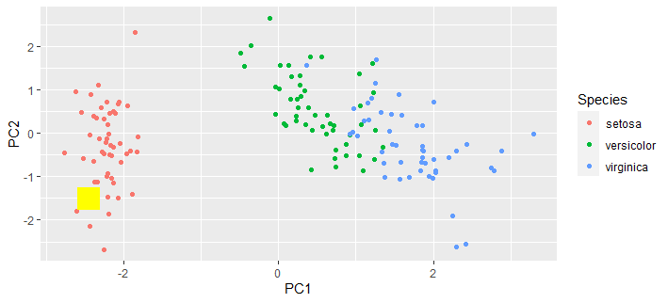
Exploring PCA With the Iris Data Set

Slide 23
Decathlon PCA Analysis
Load and explore the Decathlon data set.
How many principal components are needed to explain 50% of the variance in the data?
Can you describe the first two principal components?
Which event is least well described by the first two principal components?

Slide 24
Decathlon PCA Analysis
A new athlete has the following scores. What athlete in the data set is he most similar to?
100m: 11.40
LJ: 6.85
SP: 13.3
HJ: 1.90
400m: 51.02
110m H: 15.60
Discus: 41.21
Pole: 5.05
Javelin: 55.61
1500m: 290.11

Slide 25
tSNE
t-distributed Stochastic Neighbor Embedding
A non-linear version of PCA.
The most important parameter is perplexity which measures how many “close neighbours” each point has.
The original paper recommends a perplexity between 5 and 50.

Slide 26
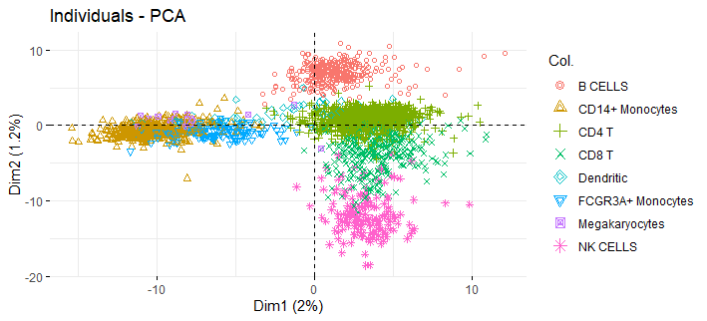
tSNE

Slide 27
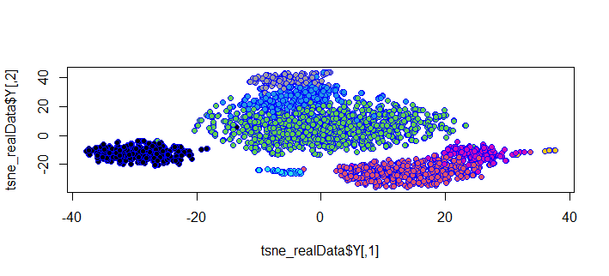
tSNE

